Slide 1
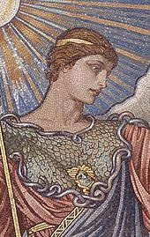
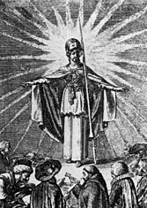
, An Introduction to the International Enlightenment (1650-1800)
David Ross, Ph.D.
http://zimmer.csufresno.edu/~davidro
April 4, 2013
History of the British Isles:
Instructor: Miss Kathie Crawford

Slide 2
British Isles: Age of Enlightenment
France: Siècle des Lumières
Holland: Leeftijd van Verlichting
Germany: Zeitalter der Aufklärung
Spain: Siglo de las Luces
Portugal: Era de Iluminação
1650-1800

Slide 3
Enlightenment Questions: 1. What were the main concepts? 2. When did it take place? 3. Which principal countries were involved? 4. Who were the main intellectuals? 5. What were their influential published works? 6. Does the Enlightenment still matter today?

Slide 4
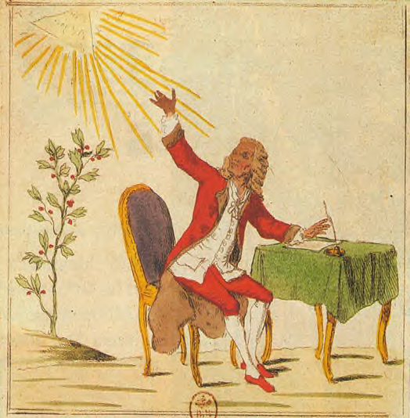
Enlightenment Values:
Reason, Science
Question All Authority
Modernity, Tolerance
Humanism
Deism, Natural Religion
Doctrine of Progress
Le Roi Voltaire
Legacy: Revolutions!
#1: Moderate, secular approach to politics, society, religion, and self-rule based on compromise.
#2: Unintended consequences, radical extremism,
oppression of dissent, …
Notes:
Enlightenment resonates in our world

Slide 5
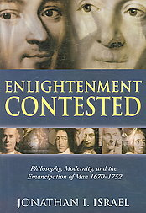
J. Israel: Two Enlightenments Theory:
1. Moderate Enlightenment:
Followers of Locke, Newton,
and Voltaire accepted
hierarchical & religious structure
of 18th C. World.
2. Radical Enlightenment:
Inspired by Spinoza and
Bayle, philosophes Diderot,
Holbach, Helvétius, Grimm
were materialists, atheists, and
egalitarians.
(2006)

Slide 6
“Modernity” according to J. Israel:
Philosophically:
Basic values: Tolerance, personal freedom, democracy, equality racial and sexual, & the universal right to knowledge and enlightenment.
Historically:
Conflict between enlightenments
& counter-enlightenments.

Slide 7
(2010)

Slide 8
(2007)

Slide 9
Cultural Revolutions: Everyday Life in Britain, North America, and France (2009), by Leora Auslander.

Slide 10
Some Key Intellectuals of the Enlightenment
Holland: Philosopher Baruch Spinoza (1632-1677)
Holland: Philosopher Pierre Bayle (1647-1706)
Britain: Philosopher John Locke (1632-1704)
Britain: Physicist Isaac Newton (1643-1727)
Britain: Economist Adam Smith (1723-1790)
France: Philosophe Voltaire (1694-1778)
France: Philosophe Denis Diderot (1713-1784)
France: (Anti)-philosophe J.J. Rousseau (1712-1778)

Slide 11
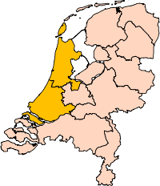
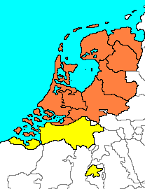
Holland (Netherlands), or Dutch Republic (United Provinces).
In the 17th & 18th Centuries
Holland was the freest country in Europe:
• Asylum of political and religious exiles: Jews, Huguenots, Jansenists, Socinians, Unitarians.
• Result: general tolerance and broadening of outlook.
1648

Slide 12
17th & 18th Century Britain and France:
Contrasting Monarchies!!
Glorious Revolution: 1688-89 Bill of Rights; Limits on monarchy prescribed by Parliament. | Absolute Monarch, ruling by divine right: police state allied with Roman Catholic Church; strong counter-Enlightenment forces.
• Toleration Act: 1689 Nonconformists granted freedom of worship; Catholics and Unitarians excluded. Relative freedom of thought; • Military and commercial successes centered in London. | • Revocation of Tolerance Edict: 1685 Protestants lose religious liberty & civil rights. “One King, One Faith, One Law.” Suppression of “esprit philosophique,” of speech and publications. A second “Hundred Years’ War”

Slide 13
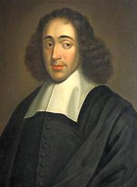
Baruch Spinoza = Bento Espinosa (1632-1677)
• Portuguese Jewish background.
• Student of religion and philosophy.
• Excommunicated by leaders of the
Jewish community.
• Worked as a humble lens grinder.
• Laid the foundations for the Enlightenment
with his works Ethics and Theologico-Politico Treatise.
• Attacked Cartesian mind-body dualism; believed God and Nature were the same substance.

Slide 14
Learn more about Spinoza
(2006)

Slide 15
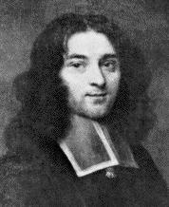
Pierre Bayle (1647-1706)
• French Huguenot, Protestant refugee
from religious persecution by Louis XIV.
• Resided in Rotterdam, Dutch Republic.
• Historical and Critical Dictionary (1695);
featured lengthy footnotes on controversial topics.
• A major influence on the development of the Enlightenment and the Encyclopédie project
• A fideist who advocated a distinction between faith and reason; considered God to be unknowable by man, and that much of what is considered truth is really opinion.
• Preached a doctrine of tolerance.

Slide 16
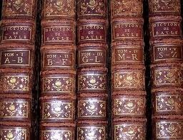
Bayle’s Dictionary was used throughout the 18th Century;
Thomas Jefferson gave his copy to the Library of Congress.

Slide 17
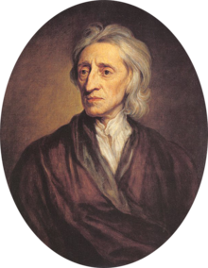
John Locke (1632-1704)
• British empiricist philosopher and political theorist.
• Anti-Cartesian epistemology: we know only what has come to us through our senses; denied we are born with innate ideas.
• Locke’s ideas greatly influenced Enlightenment thinkers,
including Voltaire, Rousseau, Hume, Kant, and American
Revolutionaries, Jefferson, Hamilton, Madison, & others.
• Two Treatises Concerning Government (1689).
• An Essay Concerning Human Understanding (1690).

Slide 18
Rights to “Life, Liberty, and Property.”

Slide 19
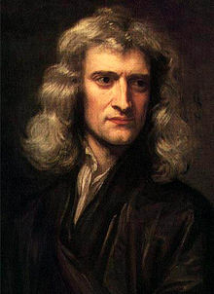
Sir Isaac Newton (1642-1727), English physicist and mathematician, key figure in the scientific revolution.
• Mathematical Principles of Natural Philosophy, (1687).
• Laid the foundations of classical mechanics, laws of motion, universal gravitation.
• Inventor of the infinitesimal calculus.
• Inventor of reflecting telescope.
• Unorthodox Christian, anti-trinitarian (?).
• Taught at the University of Cambridge.
• President of the Royal Society.
• Master of the Royal Mint.

Slide 20
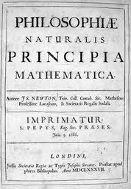
Newton’s Mathematical Principals first appeared in Latin (1687)
Madame du Châtelet's 1759 translation of Principia Mathematica is still the standard translation of the work into French.

Slide 21
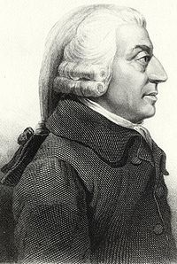
Adam Smith (1723-1790)
• Scottish moral philosopher & pioneer of political economy (economics).
• Author of The Wealth of Nations (1776).
• Described how market forces
could support a self-organizing division of labor, the “invisible hand”.
• The state has powerful responsibilities regarding defense, justice, infrastructure, & education.
• Collective action needed to compliment private-market forces.

Slide 22
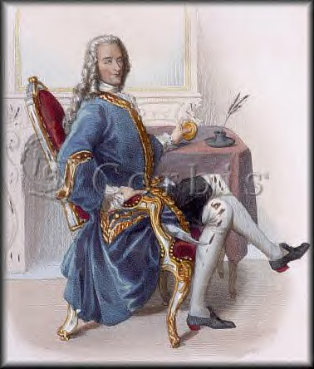
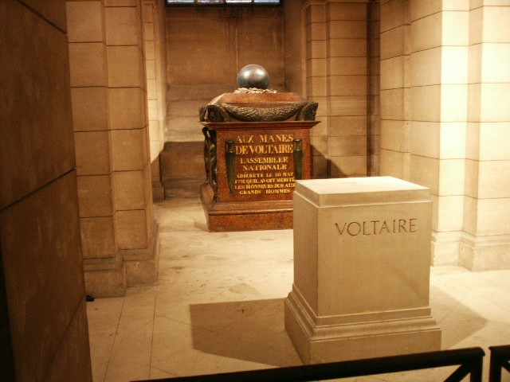
Voltaire*
(1694-1778)
Voltaire’s tomb in the Paris Panthéon
The Age of Enlightenment is often called the Age of Voltaire, or the Age of Reason.

Slide 23
Letters Concerning the English Nation
• A bomb thrown against the Ancien Régime in France
• Purpose: Demonstrate Britain’s superiority over France:
Religion, politics, science, trade and commerce, medicine, famous Britons, art & literature.
• Anti-Pascal comments end the French edition, hence the title Lettres Philosophiques.
(1734)

Slide 24
Letters on the English Nation, Lettres philosophiques.
Letters I – 4, On the Quakers.
5: On the Church of England.
6. On the Presbyterians.
7. On the Socinians or Arians.
8. On the Parliament.
9. On the Government.
10. On trade.
11. On Inoculation.
12. On Lord Bacon.
13. On Mr. Locke.
14 – 17. On Descartes and Sir Isaac Newton …
18 – 23. On Art and Literature ...
24. On the Royal Society and other Academies.
25. On Pascal.

Slide 25
Features of my edition:
• Full Text of 1759 Novel in French.
• Introduction and cultural notes in English.
• French-English glossary.
Voltaire’s Objectives in Candide:
• Amuse and Instruct.
• Review the causes of human misfortune.
• Destroy the doctrine of optimism (divine Providence)
• Argue against war, slavery, condition of women.
• Promote tolerance and common sense.
•
(2007)

Slide 26
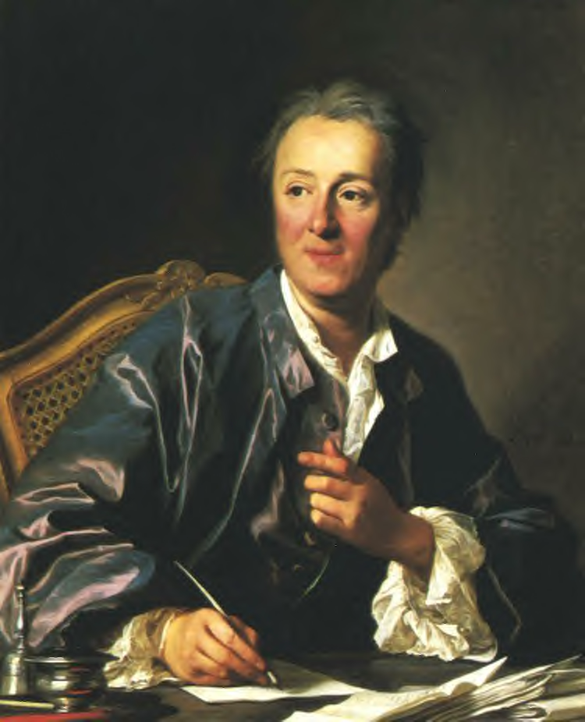
Denis Diderot (1713-1784)
• French philosophe, encyclopedist, art critic, writer.
• Initially contracted to translate Chamber’s Cylopedia from English to French.
• Convinced the publisher to expand the project to produce the first true Encylopédie, the masterpiece of the Enlightenment

Slide 27
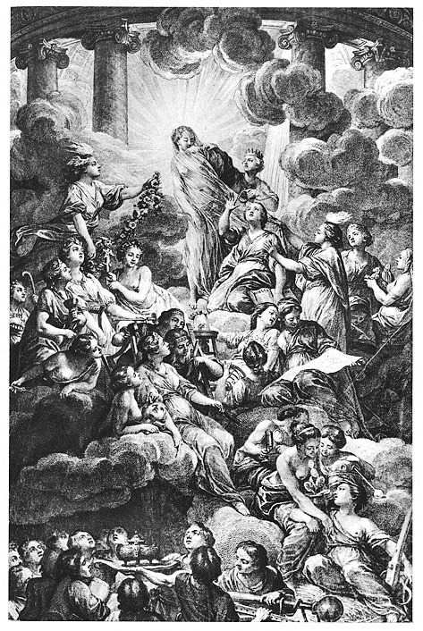
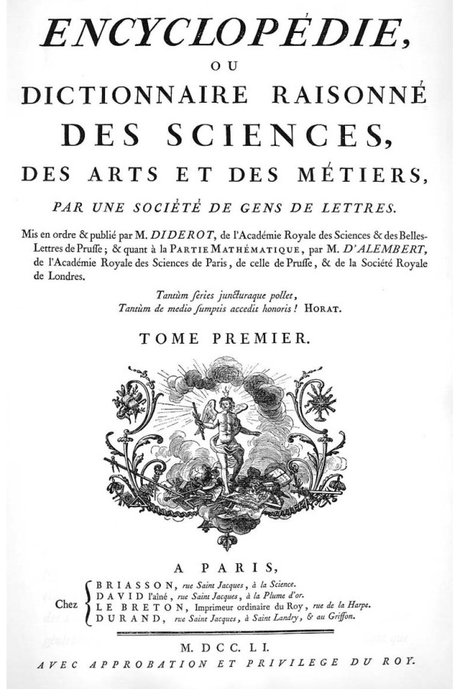
Paris: 1751-1780, 35 vols, in-folio.

Slide 28
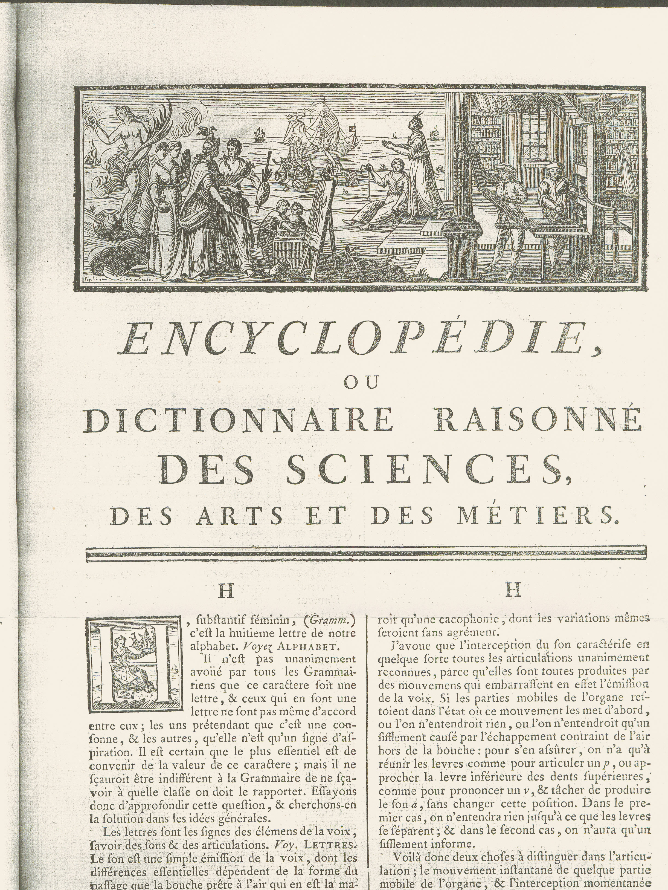
A principal reference work for those who read French
at a time when French was the cultural language of Europe.
Thomas Jefferson owned a full set.

Slide 29
The Purposes of the Encyclopédie:
• Change the common way of thinking.
•Advance the modern, rational, skeptical, secular
agenda of the Enlightenment.
• Question all authority.
• Denounce abuses by the Roman Catholic Church
allied with the State.
• Ultimately successful due to size of commercial
enterprise: “too big to fail!!”
Notes:
29

Slide 30
Taxonomy
Of Human
Knowledge inserted in the
Encyclopédie
Knowledge
of God is
located near
“Black Magic.”
Notes:
30

Slide 31
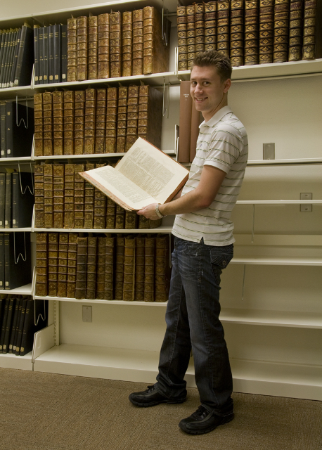
CSU Fresno
Madden Library
Special Collections

Slide 32
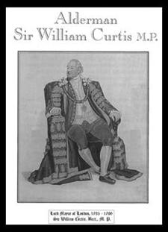
Fresno State’s Complete Set of
Encyclopédie + Supplément + Tables was owned by
William Curtis (1752-1829), baronet.
His name plate is inside each of 35 vols.
MP for London 28 years (1790-1818).
Lord Mayor (1795-1796).
Sea Biscuit Manufacturer and Banker.
First to Define “3 R’s” as:
Reading, ‘Riting, ‘Rithmetic!

Slide 33
ARTFL: American and French Research
on the Treasures of the French Language
University of Chicago+ CNRS: Conseil National de Recherche Scientifique

Slide 34
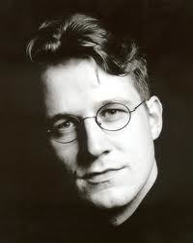
Learn More About the Encyclopédie of Diderot & Jaucourt!
Subtitle:
Encyclopédie, The Book
that Changed the
Course of History
(2005)

Slide 35
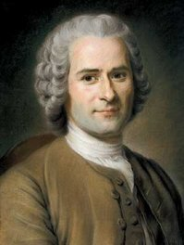
Jean-Jacques Rousseau (1712-1778)
• Swiss-French philosopher, author, political theorist, composer.
• At first, a disciple of Voltaire.
• Rejected Voltaire’s attacks on Providence in Candide.
• Rousseau professed a need to believe in a Providential deity (natural religion).
• Rejected the Enlightenment utopian doctrine of progress and perfectibility.
• Rousseau’s position was that civilization & society had corrupted man.
• Very original, influential ideas on education, the raising of children, the politics of social contract.

Slide 36
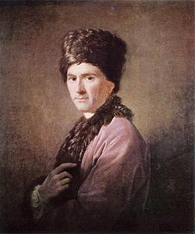
Some of Rousseau’s important publications:
• Discourse on the Arts and Sciences (1750): man is good at birth, then corrupted by civilization and society.
• Articles on Music for Diderot’s Encyclopédie (1750s).
• Discourse on Inequality (1754): control by the wealthy.
• Julie, or the New Heloise (1761): novel of sentiment.
• The Social Contract (1762): freedom is submission to the “general will;” submit or face execution!
• Emile, on Education (1762): education &
natural religion; book condemned and
burned in Paris & Geneva by church authorities.
• Confessions (1769): autobiography.

Slide 37
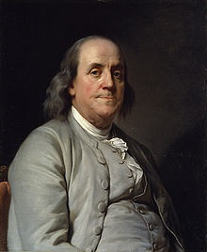
Benjamin Franklin (1706-1790)
• Major American contributor to the
Atlantic Enlightenment; gained
international recognition for his
original research in electricity,
inventor of the lightning rod.
• A polymath genius: author, printer,
Political theorist, politician, physicist, scientist, musician, inventor, civic activist, statesman, diplomat, postmaster, abolitionist.
• Ambassador to London, and subsequently to Versailles; by his person and manner he exemplified for Europeans the American colonists and their full potential.

Slide 38
Highly recommended reading!
(2003)

Slide 39
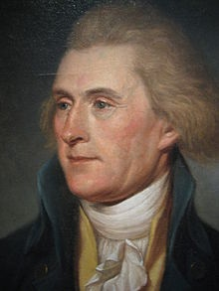
Thomas Jefferson (1743-1826)
• A polymath American leader in the
International Enlightenment.
• Principal author of the American
Declaration of Independence based
on Enlightenment ideals and values:
life, liberty, & pursuit of happiness.
• Jeffersonian Democracy meant equality of opportunity; devotion to republicanism & to civic duty; opposition to
privilege, aristocracy, corruption.
• One of our greatest presidents, he was a gifted and complex individual: Francophile, deist, and slave owner.

Slide 40
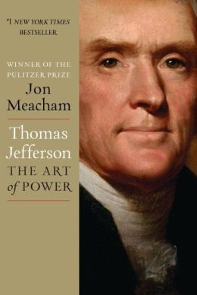
A recent bestseller on Thomas Jefferson.
(2012)

Slide 41
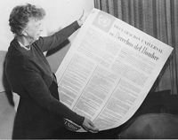
Declarations of Rights &
Enlightenment ideals
• 1689 British Parliament adopted a Bill of Rights still in effect; strong Lockean influence.
• 1789 French Constituent Assembly adopted a Declaration of the Rights of Man and the Citizen. Drafted in ambassador Jefferson’s Paris apartment by Layfayette and others.
• 1789 Congressional approval, American Bill of Rights. Introduced by Madison, Jefferson’s protégé.
• 1948 United Nations, General Assembly, approved the Universal Declaration of Human Rights in the Herbst Theatre in San Francisco.

Slide 42
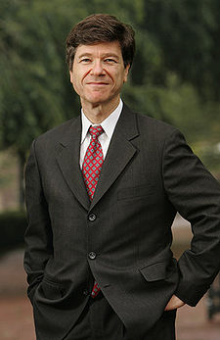
Testimony to the enduring legacy of the Enlightenment from …
Jeffrey Sachs: Professor of Economics,
Columbia University

Slide 43
(2005)

Slide 44
Jeffrey Sachs directed the UN Millenium Development Goals Project (2006)
• Called for richest countries to reduce poverty, disease and hunger by 2015.
• The basis for globalised social justice:
• The 18th Century Enlightenment concepts
of economic and social progress
• The Enlightenment produced our modern
world.

Slide 45
Enlightenment Quiz! 1. Enumerate the main Enlightenment concepts. 2. When did it take place approximately? 3. In which principal countries? 4. Name some principal intellectuals. 5. List their most influential published works. 6. Does the Enlightenment still matter today?

